Slide 1


Technical Presentation
Assessment Tool-3
CSA0501-Database Management System
E . Rohan 192524482

Slide 2
Q1 · INTRODUCTION TO DBMS
03
What Is a DBMS — and Why Do We Need One?
A Database Management System (DBMS) is software that lets users define, create, populate, query, update and administer a database — acting as the controlled interface between raw stored data and every user or application that needs it.
Users & Applications
DBMS (Software Layer)
Core Objectives
Data independence — isolate applications from storage details
Minimize redundancy while maximizing consistency
Efficient access via indexing and query optimization
Enforce integrity, security and access control
Support concurrent multi-user access safely
Provide backup, recovery and crash resilience
Physical Database (Stored Data)
Definition
Integrity
Security
Concurrency

Slide 3
Q1 · INTRODUCTION TO DBMS
04
Advantages and Real-World Applications
Key Advantages
Real-World Applications
Reduced data redundancy through centralized storage
Consistent, integrity-checked data across the enterprise
Controlled, concurrent data sharing among many users
Fine-grained security and role-based access control
Enforced standards and constraints on stored data
Reliable backup and automated crash recovery
Faster development via SQL instead of custom file code
Banking – Secure transaction management
Airline Reservation – Ticket booking & scheduling
Universities – Student records management
E-Commerce – Online sales & orders Healthcare – Patient information systems
Telecom – Customer & billing management
Manufacturing / ERP – Inventory & resource planning

Slide 4
Q2 · FILE SYSTEMS VS DBMS
05
Why Organizations Moved Away from File-Based Systems
Criteria
File-Based System
DBMS
Data Redundancy
High — duplicated across files
Minimized via centralized storage
Data Consistency
Hard to maintain, manual sync
Maintained through constraints
Data Sharing
Limited, program-specific access
Controlled concurrent multi-user access
Security
File-level, coarse-grained
Fine-grained, role-based access
Data Independence
None — programs tied to file layout
Logical & physical independence
Backup & Recovery
Manual, error-prone
Automated, transaction-based

Slide 5
Q2 · FILE SYSTEMS VS DBMS
06
Case Studies: Banking and Healthcare
B
Banking
Healthcare
Before: each branch kept separate customer files — duplicate, inconsistent records across branches.
With a DBMS: a centralized core-banking database gives real-time balance updates and shared customer data across every branch.
Why it matters: ACID transactions guarantee that a fund transfer either fully completes or fully rolls back, and cross-table joins support fraud detection.
Before: paper or isolated files meant lost patient history and repeated diagnostic tests.
With a DBMS: an Electronic Health Record (EHR) system links demographics, diagnoses, prescriptions and lab results in one place.
Why it matters: controlled access with audit trails protects patient privacy while enabling faster, coordinated care across departments.

Slide 6
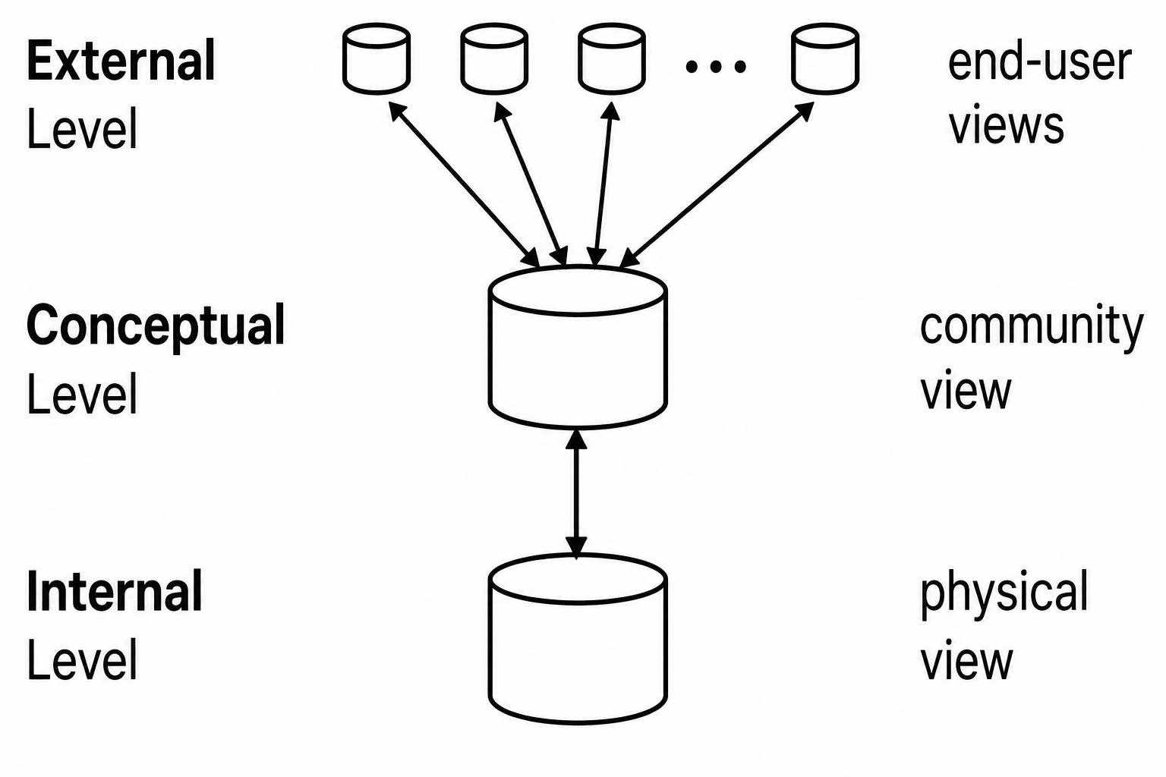
Q3 · DBMS ARCHITECTURE
07
The Three-Level ANSI/SPARC Architecture

Slide 7
Q3 · DBMS ARCHITECTURE
08
Mappings in Practice — A University Example
Why Two Mappings Matter
University Database
External/Conceptual mapping links each user view to the single conceptual schema
Conceptual/Internal mapping links that schema to physical storage
Changing one level does not force changes in the others
This separation is the basis of logical and physical data independence (see Q7)
Registrar View
Student · Course · Enrollment
Library View
Student · Book · Loan
Conceptual Schema
(one logical structure)
Physical Storage
B+ Tree index on Student_ID

Slide 8
Q4 · DATA MODELS
09
Hierarchical, Network and Relational Models
Hierarchical
Network
Relational
Company
Supplier
Part
ID
Name
Dept
S1
Asha
CSE
Dept A
Dept B
Shipment
S2
Ravi
ECE
S3
Neha
CSE
Emp 1
Emp 2
One-to-many parent-child links only;
fast to navigate, rigid to restructure.
Records can have multiple owners —
many-to-many sets via a link record.
Data stored as simple rows and columns
linked by shared key values.

Slide 9
Q4 · DATA MODELS
10
Where Each Model Is Used in Industry
Hierarchical
Industry use:
IBM IMS; legacy banking systems; XML document stores
Why: Fast when data is naturally tree-shaped, e.g. an org chart
Network
Industry use:
IDMS; early airline reservation and telecom systems
Why: Handles complex many-to-many links better than hierarchical
Relational
Industry use:
Oracle, MySQL, PostgreSQL, SQL Server
Why: Today's default: e-commerce, banking, ERP, CRM platforms

Slide 10
Q5 · ER MODELING
11
ER Diagram — Online Library System
Member_ID (PK), Name
Book_ID (PK), Title, Author
Staff_ID (PK), Name
MEMBER
M
BORROWS
N
BOOK
1
MANAGES
N
LIBRARIAN
Issue_Date, Due_Date
A Member BORROWS many Books over time (M:N), recorded with Issue_Date and Due_Date. A LIBRARIAN MANAGES the Book catalogue (1:N) — one librarian oversees many book records.

Slide 11
Q5 · ER MODELING
12
Reading the Library ER Diagram
1
Rectangles = Entities
MEMBER, BOOK and LIBRARIAN are entity types — real-world objects the library tracks independently.
2
Ellipses = Attributes
Each entity carries descriptive attributes; underlined attributes (Member_ID, Book_ID, Staff_ID) are primary keys.
3
Diamonds = Relationships
BORROWS connects Member and Book; MANAGES connects Librarian and Book — each diamond names how entities interact.
4
Lines = Cardinality
BORROWS is many-to-many (a member borrows many books, a book is borrowed by many members over time); MANAGES is one-to-many.

Slide 12
Q6 · EER MODELING
13
EER Diagram — University: Generalization & Specialization
Person_ID (PK)
Name, Address
PERSON
ISA
Disjoint, Total Specialization
Roll_No, Program
STUDENT
FACULTY
ISA
Disjoint, Partial Specialization
Emp_ID, Department
UNDERGRAD
GRADUATE

Slide 13
Q6 · EER MODELING
14
Why Generalize / Specialize the University Model?
Generalization (Bottom-Up)
Specialization (Top-Down)
Start from STUDENT and FACULTY, notice shared attributes (ID, Name, Address)
Factor those common attributes up into a PERSON superclass
Removes duplicate attribute definitions and duplicate storage
Shared relationships (e.g. Person has an Address) are defined once
Start from PERSON and split it into meaningful roles: STUDENT, FACULTY
Each subclass adds attributes only it needs (Roll_No vs Employee_ID)
Total & disjoint here: every person is exactly one of the two roles
STUDENT is specialized again into UNDERGRADUATE / GRADUATE for finer detail

Slide 14
Q7 · DATA INDEPENDENCE
15
Logical vs Physical Data Independence
Logical Data Independence
Physical Data Independence
The ability to change the conceptual schema (e.g. add a new attribute or entity) without rewriting external views or application programs.
Example: adding an Email column to the Student table doesn't break existing queries that never reference it.
The ability to change the internal schema (storage structures, file organization, indexes) without changing the conceptual schema.
Example: switching Student storage from a sequential file to a B+ tree index doesn't affect any application logic.
Significance
Enables schema evolution over time while cutting maintenance cost and isolating users from implementation detail — the very foundation the three-level ANSI/SPARC architecture (Q3) is built to provide.

Slide 15
Q8 · DBMS SOFTWARE COMPONENTS
16
Inside the DBMS Engine
Users / Applications
DDL / DML Compiler
Query Processor
Transaction Manager
Parses schema & query language into internal executable form
Enforces ACID, concurrency control & recovery via the log
Storage Manager
Physical Database
Database Management Systems • CSA05 • Assessment Tool 3

Slide 16
Q8 · DBMS SOFTWARE COMPONENTS
17
What Each Component Actually Does
Query Processor
Parses incoming SQL for syntax and semantics, then the Query Optimizer chooses the most efficient execution plan (which index to use, join order, etc.) before handing it off for execution.
1
Storage Manager
Controls how data actually sits on disk: the File Manager organizes records, the Buffer Manager caches pages in memory, and index structures speed up retrieval of matching rows.
2
Transaction Manager
Guarantees ACID properties for every transaction — Atomicity, Consistency, Isolation, Durability — using locking or timestamping for concurrency control and the log for crash recovery.
3

Slide 17
Q9 · STRONG VS WEAK ENTITIES
18
Two Kinds of Entities in ER Modeling
Employee_ID (PK)
Dependent_Name (partial key)
EMPLOYEE
HAS DEPENDENT
DEPENDENT
1
N
Strong Entity
Weak Entity
Notation
Single-line rectangle
Double-line rectangle
Primary Key
Has its own PK
No PK of its own — needs a partial key
Existence
Exists independently
Depends on an owner (identifying) entity
Example here
EMPLOYEE
DEPENDENT (identified through Employee_ID)
Database Management Systems • CSA05 • Assessment Tool 3

Slide 18
Q10 · EER DESIGN
19
EER Diagram — Retail Chain Management System
EMPLOYEE
ISA
Disjoint, total specialization
MANAGER
CASHIER
STOCK CLERK
Each store also has its own staff (1:N Employee) — captured in prose below.
STORE
INVENTORY
PRODUCT
SALE
CUSTOMER
Stock_Level
Sale_Date, Quantity
EMPLOYEE specializes (disjoint, total) into MANAGER, CASHIER and STOCK CLERK; each STORE staffs many Employees (1:N). STORE stocks PRODUCT via INVENTORY (M:N, Stock_Level); CUSTOMER purchases PRODUCT via SALE (M:N), timestamped with Sale_Date and Quantity.

Slide 19
Q10 · EER DESIGN
20
Design Walkthrough — Step by Step
1
Identify entities
2
Model the role hierarchy
STORE, EMPLOYEE, PRODUCT, CUSTOMER — the core objects the chain must track.
EMPLOYEE is generalized, then specialized (disjoint, total) into MANAGER, CASHIER, STOCK CLERK so role-specific attributes stay separate.
3
Define relationships & cardinality
4
Assign keys & attributes
STORE–PRODUCT via INVENTORY (M:N, stock level); CUSTOMER–PRODUCT via SALE (M:N, date & quantity); STORE–EMPLOYEE (1:N).
Give every entity a primary key (Store_ID, Product_ID, Customer_ID, Emp_ID) and the descriptive attributes it needs.
5
Resolve many-to-many links
6
Integrate into one EER schema
Introduce associative attributes/entities on INVENTORY and SALE to carry facts that belong to the relationship itself, not to either entity alone.
Combine every piece into a single enterprise-wide model that scales across multiple stores in the chain.
Database Management Systems • CSA05 • Assessment Tool 3

